Slide 1
My name is Ahmet Fevzi Akargöl, and today I will be presenting my final year project on 'Trajectory Design for Lunar CubeSat Missions,' supervised by Professor Dr. Alim Rüstem Aslan.
Trajectory Design for Lunar CubeSat Missions
26.06.2024
Ahmet Fevzi Akargöl
Advisor: Prof. Dr. Alim Rüstem Aslan

Slide 2
Outline
In today's presentation, we'll begin with the motivation and aims of the project. Then, I will cover the background of the mission challenge and our methodological approach. The core of the presentation will be the simulation section, where I will walk you through the entire process, from overcoming theoretical challenges to the final trajectory design. We will conclude with the results, my final evaluation, and a Q&A session.
1. Motivation: Why this topic?
2.Aims & Scope: What did we aim to achieve?
3. Background & Methodology: The context and our approach.
4.Simulation: From Theory to Practice
The Challenge: Theory vs. Reality
Building the CR3BP Environment
Defining the Target Orbit
Trajectory Design Tools
The Full Trajectory Sequence
5.Results & Conclusion: Key findings and evaluation.

Slide 3
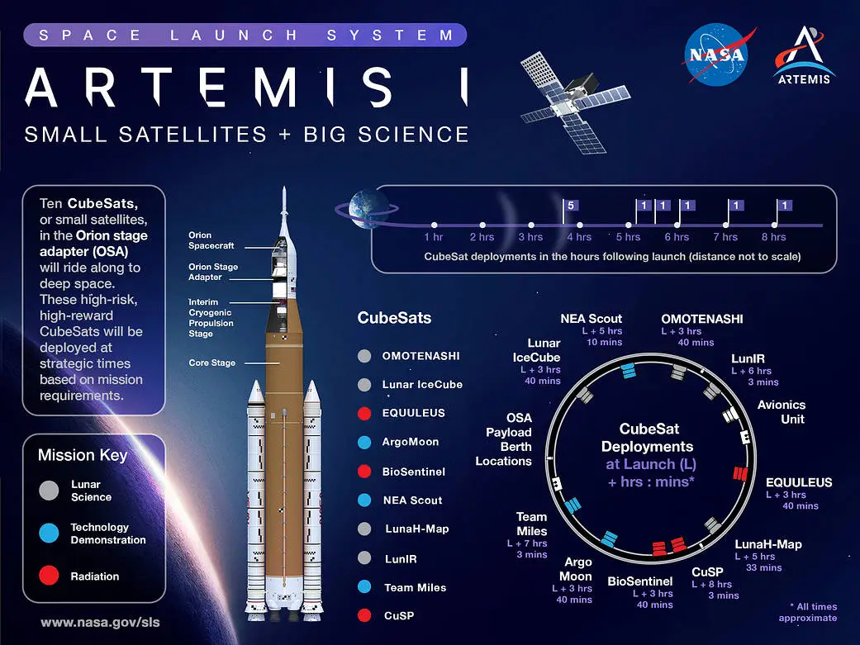
Talking Points: "CubeSats have truly revolutionized access to space. For the last two decades, their low cost and standardized form factor have democratized space. We are now witnessing a major shift as these small platforms are pushed beyond LEO and into deep space. The Artemis-1 mission was a landmark moment in this shift, demonstrating the incredible potential of small satellites as secondary payloads for deep space science. However, the mission also served as a stark reminder of the harsh realities. Of the ten CubeSats deployed, several experienced critical issues. This is not seen as a failure, but rather as a crucial learning experience, providing invaluable data on the challenges of deep space operations."
1. Introduction & Motivation
The CubeSat Revolution: From LEO to Deep Space.
Artemis-1: A New Frontier for Small Satellites.
A Landmark Mission: Proving Potential In the Face of High-Risk Challenges.

Slide 4
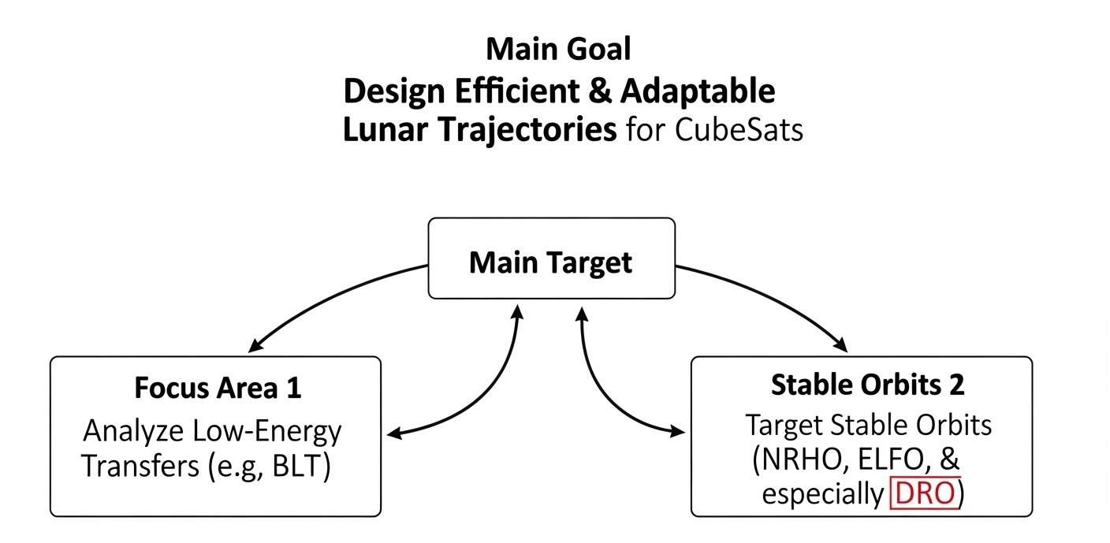
1. Project Aims & Scope
Talking Points: "The primary goal of this project was to design efficient and adaptable lunar trajectories for CubeSats. To achieve this, we focused on two main areas: investigating low-energy transfer trajectories and targeting strategically important and stable orbits around the Moon. In our work, we concentrated specifically on the Distant Retrograde Orbit (DRO) due to its unique stability and its relevance to the Artemis program."

Slide 5
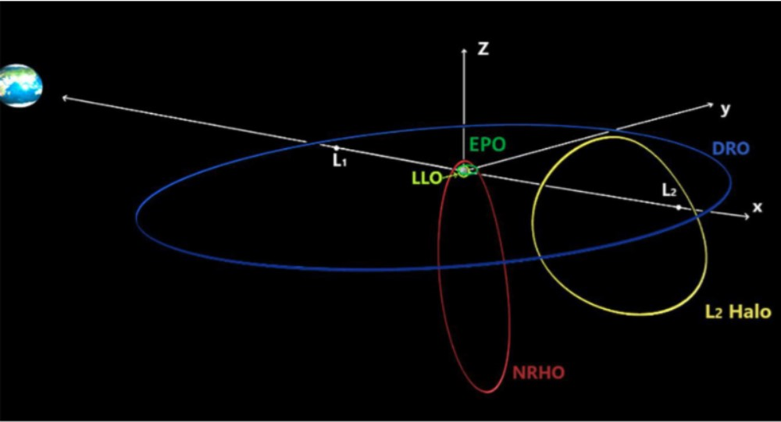
Talking Points: "Before starting our design, we needed to understand the fundamental problem. A standard lunar transfer requires a total Delta-V of about 4,000 m/s. The largest part of this budget, the Earth escape maneuver requiring ~3,100 m/s, single-handedly exceeds the capabilities of CubeSat propulsion systems. This fundamental constraint means CubeSats must have a 'ride'—either as a secondary payload on a large launcher or by using an orbital transfer vehicle. Therefore, our work focuses on what happens after this initial step: Once a CubeSat is deployed on a lunar transfer trajectory, how can it most efficiently complete its mission with its limited fuel? This is where stable and low-energy orbits like NRHO, ELFO, and our project's focus, the DRO, emerge as the solution space."
2. The Mission Challenge & Our Approach
ΔV Problem: Direct Transfer: ~4,000 m/s
TLI Hurdle: Earth Escape: ~3,100 m/s
CubeSat Limitation: Insufficient ΔV for TLI
Solution: Rideshare / OTV required
Our Focus: Post-TLI trajectory optimization
Ref: NASA. WHY NRHO: THE ARTEMIS ORBIT. White Paper - Architecture Concept Review. 2022. URL: https:
//www.lpi.usra.edu/lunar/artemis/resources/WhitePaper_2023_WhyNRHA-TheArtemisOrbit.
pdf.

Slide 6
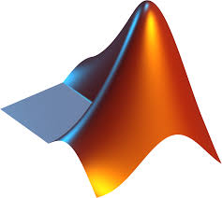

Talking Points: "To solve this problem, we followed a two-stage methodology: We used MATLAB for preliminary analyses, then moved to STK for high-fidelity design and validation. To test our entire approach, we used a real case study: the Artemis-1 mission. This mission served as both a reference point and a validation scenario. The Artemis-1 CubeSats taught us invaluable lessons; most importantly, that just getting a ride to deep space isn't enough, and the reliability of the onboard systems is absolutely critical for mission success."
2. Methodology & Case Study
Workflow: MATLAB (Analysis) → STK (Design & Simulation)
Benchmark: Artemis-1 Mission Profile
Key Lesson: Onboard System Reliability is Critical
Ref: NASA. WHY NRHO: THE ARTEMIS ORBIT. White Paper - Architecture Concept Review. 2022. URL: https:
//www.lpi.usra.edu/lunar/artemis/resources/WhitePaper_2023_WhyNRHA-TheArtemisOrbit.
pdf.

Slide 7
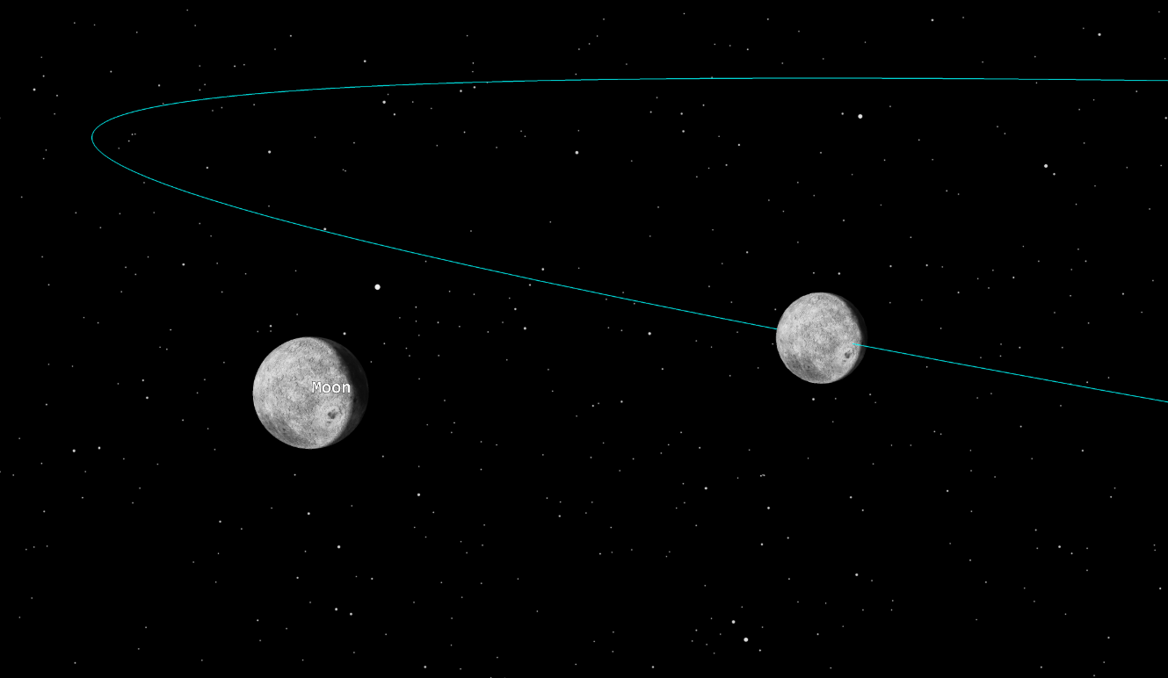
"When we moved to the simulation phase, our initial goal was to recreate the Artemis-1 trajectory in STK using NASA's published ephemeris data. However, we encountered a fundamental theoretical challenge. For a successful DRO trajectory design, we needed to use the Three-Body Problem model, which allows us to understand and control the system's dynamics. At this point, we decided to use the Circular Restricted Three-Body Problem (CR3BP), as it is more comprehensible and, most importantly, allows for an integral of motion like the Jacobi Constant. The Jacobi Constant represents the energy level of the orbit, and its conservation throughout an orbit is the strongest way to confirm the simulation's accuracy and that the spacecraft is on the correct path. However, the CR3BP model assumes that the Earth and Moon orbit in perfect circles. The real lunar orbit is elliptical. This conflict, as you can see, creates a positional difference between our 'Idealized Moon' and the real Moon in the simulation. Therefore, instead of replicating the mission in every detail, we decided to reconstruct the mission's fundamental design within the consistent mathematical framework of the CR3BP."
3. Theory vs. Reality
Problem: Elliptical Reality vs. Circular Model
Conflict: Direct "Playback" Impossible
Solution: Reconstruct Mission within CR3BP Framework

Slide 8
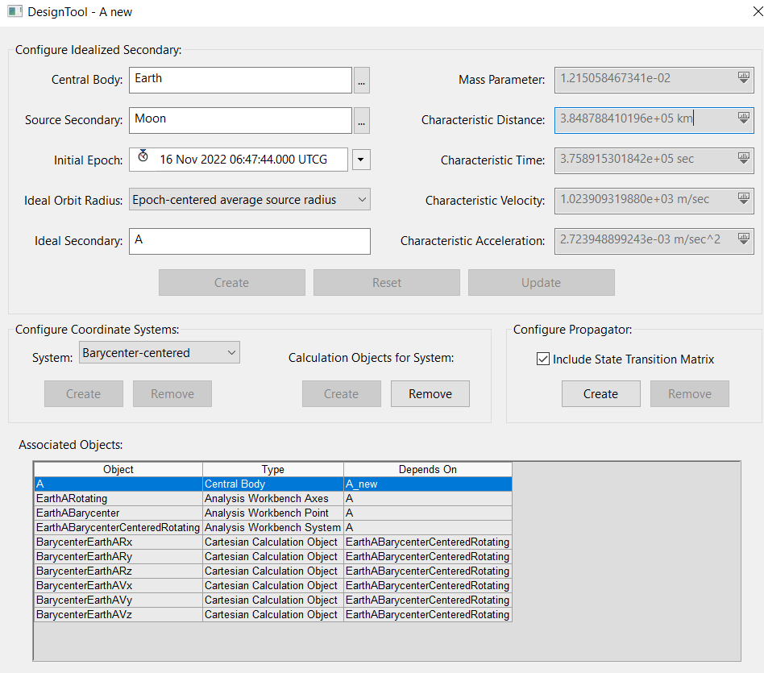
"To overcome this challenge and create a consistent analysis environment, our first step was to use STK's CR3BP Setup Tool. We configured this tool using the Artemis-1 launch time, November 16, 2022, as the reference epoch. This ensured our idealized system was as close as possible to the configuration at the actual start of the mission. The tool created a virtual 'Ideal Moon' for us, moving in a perfect circular orbit, and calculated fundamental constants specific to this system, such as the mass parameter and characteristic length. However, its most critical output was the automatic definition of the barycentric, rotating reference frame, which is mandatory for analyzing periodic orbits like the DRO. This setup formed the foundation of our analysis."
3. Building the CR3BP Environment
Tool: CR3BP Setup Tool
Action: Create "Ideal Moon" (Circular Orbit)
Result: Establish Barycentric, Rotating Frame

Slide 9
Talking Points: "Once our environment was set up, we needed to precisely define our target DRO. For this, we used NASA JPL's public Periodic Orbit Database. This database provided us with a non-dimensional initial state vector for our desired DRO. To use this data in STK, we had to dimensionalize it. We did this using the Characteristic Distance and Characteristic Velocity values calculated by the CR3BP Setup Tool. By multiplying the non-dimensional components by these scaling factors, we obtained the precise initial state vector in kilometers and km/s, which established the starting point for our simulation."
3. Defining the Target Orbit
Distance (1 LU): 384878.8410196 km Velocity (1 LU/TU): 1.023909319880 km/s
Component | NASA Input (Dimensionless) | Calculation | Earth-Moon Barycenter State
Position X | 0.960 LU | 0.960 * 384878.841... km | 369483.687 km
Position Y | ~0 LU | ~0 * 384878.841... Km | 0 km
Position Z | ~0 LU | ~0 * 384878.841... km | 0 km
Velocity Vx | ~0 LU/TU | ~0 * 1.023909... km/s | 0 km/s
Velocity Vy | 0.692 LU/TU | 0.692 * 1.023909... km/s | 0.708545 km/s
Velocity Vz | ~0 LU/TU | ~0 * 1.023909... km/s | 0 km/s
Eccentricity | Inclination (degrees) | RAAN (degrees) | True Anomaly (degrees) | Semimajor Axis (km)
0.0019 - 0.0125 | 174.727 | 223.026 | 0.0 - 359.8 | 10786.68 - 10844.46
Ref: https://ssd.jpl.nasa.gov/tools/periodic_orbits.html

Slide 10
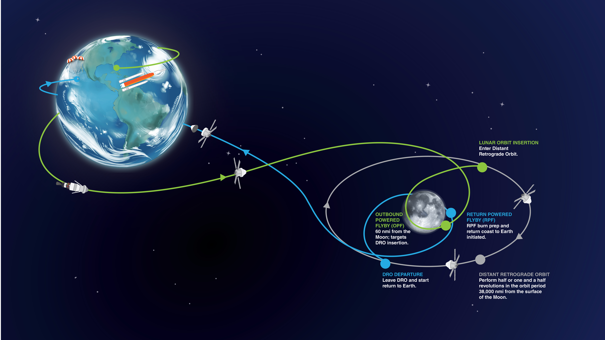
Talking Points: "Let's take a closer look at the Distant Retrograde Orbit, which is central to our project. A DRO is fundamentally a stable, periodic orbit that exists within the Circular Restricted Three-Body Problem. It's called 'Distant' because it's at a very high altitude from the lunar surface, often extending beyond the L1 and L2 Lagrange points. This distance allows it to avoid perturbations from the Moon's irregular gravitational field. It's 'Retrograde' because when observed from a reference frame rotating with the Earth-Moon system, it orbits in the opposite direction of the Moon's orbital motion. The combination of these two properties gives the DRO its greatest advantage: exceptional long-term stability. This means the amount of fuel required to maintain the orbit—station-keeping—is minimal. Because of this feature, it has been strategically used as a 'parking orbit' in pioneering missions like NASA's Artemis-1 and China's Chang'e 5."
3. Defining the Target Orbit
Definition: Stable, periodic CR3BP orbit.
Geometry: High altitude ("Distant") & opposite motion ("Retrograde").
Key Feature: High stability → Minimal station-keeping fuel.
Heritage: Flown by Artemis I & Chang'e 5.
Ref: https://www.nasa.gov/missions/orion-will-go-the-distance-in-retrograde-orbit-during-artemis-i/

Slide 11
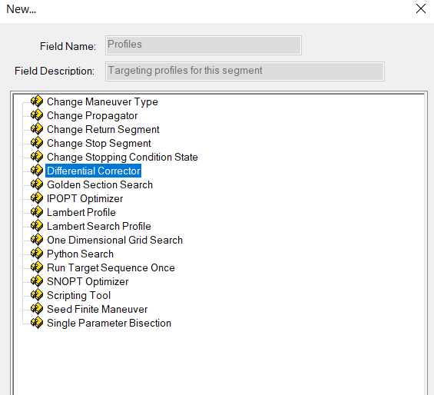
Talking Points: "To design the trajectory and precisely place it on target, we utilized the powerful targeting tools offered by Astrogator. We considered three main tools. Our primary tool was the Differential Corrector. This is a multi-variable root-finding algorithm based on the Newton-Raphson method. It iteratively solves the question, 'What should my maneuver components be to reach a specific orbital element or position?' by calculating a Jacobian (or sensitivity) matrix. The second option, SNOPT, is a more advanced Nonlinear Optimizer. This tool solves optimization problems like, 'How do I minimize my total fuel consumption while still reaching the target?' using algorithms like Sequential Quadratic Programming (SQP). Our third tool is the Scripting Tool. This is used to provide a good 'initial guess' or to automate complex parameters like B-Plane targeting, especially when the targeter has difficulty converging. In our work, we primarily used the Differential Corrector to precisely target the state vector of a specific DRO and simplified the problem to resolve convergence issues we encountered."
3. Trajectory Design Tools
Differential Corrector: Precision Targeting
SNOPT: Cost Minimization
Scripting Tool: Complex Calculations

Slide 12
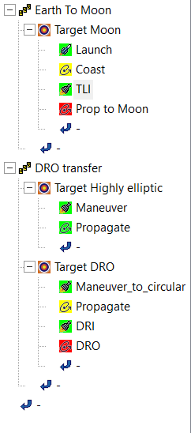
Talking Points: "Here is the general overview of our simulation. In phase one, the launch vehicle places our spacecraft into a 300 km circular orbit, after which we conduct the TLI burn requiring about 3100 m/s. In phase two, upon approaching the Moon, we burn our engines at the perigee of our hyperbolic path to enter a highly elliptical orbit, with an apogee matching the DRO's altitude. In phase three, we perform another burn at this apogee to circularize our path, making it very similar to the target DRO. Finally, in phase four, we execute a small, precise maneuver of just 7 m/s to lock into the final DRO."
3. Earth-to-DRO Transfer
Phase 1: Earth to Moon | ΔV: ~3107 m/s
Phase 2: Lunar Capture & (Highly Elliptical) | ΔV: ~310 m/s
Phase 3: Orbit Shaping (Circularization) | ΔV: ~311 m/s
Phase 4: Final Insertion into DRO | ΔV: ~7.14 m/s

Slide 13
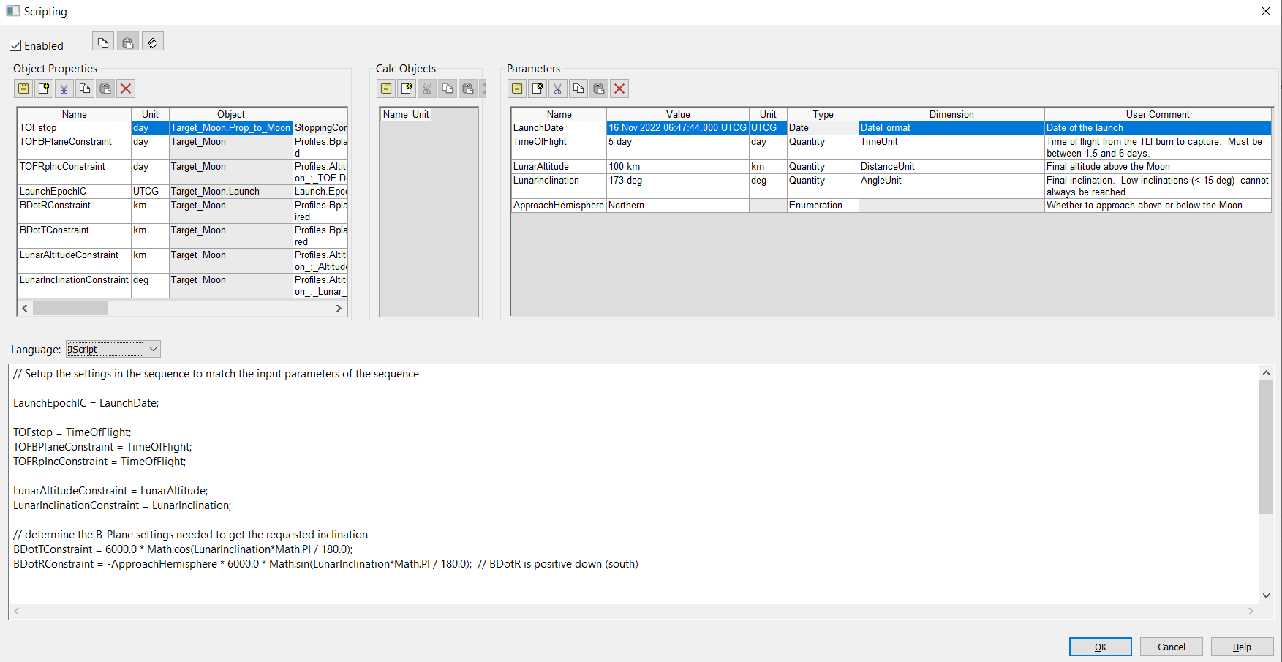
Talking Points: "To manage the complex first phase of the transfer, we used Astrogator's Scripting Tool. This is the heart of our Earth-to-Moon transfer. In the 'Parameters' section on the right, we input our goals like launch date ,time of flight, lunar altitude and lunar inclination. The JScript code in the middle then automatically calculates the complex B-Plane targeting parameters needed by the Differential Corrector. These are then passed to the simulation objects on the left. This automation allowed us to run trade studies, like changing the flight duration, with incredible speed and efficiency."
3. Phase 1: Earth-to-Moon

Slide 14
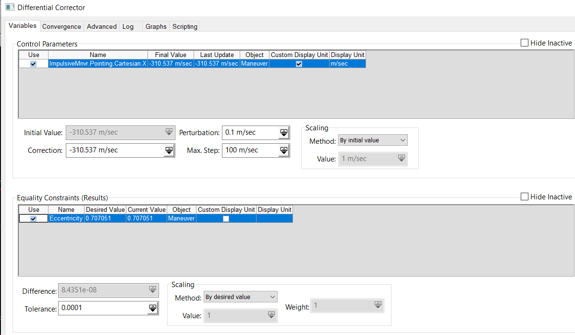
Talking Points: "In phase two, upon arrival at the Moon, we encountered convergence difficulties when trying to target the final DRO directly. As an engineering solution, we broke the problem down. Instead of a single complex maneuver, we first targeted an intermediate, highly elliptical orbit. As you can see in the Differential Corrector settings, we targeted an eccentricity of 0.707. This required a burn of approximately 310 m/s, which successfully placed us into a stable staging orbit, preparing us for the next step."
3. Phase 2: Capture - Elliptical Orbit

Slide 15
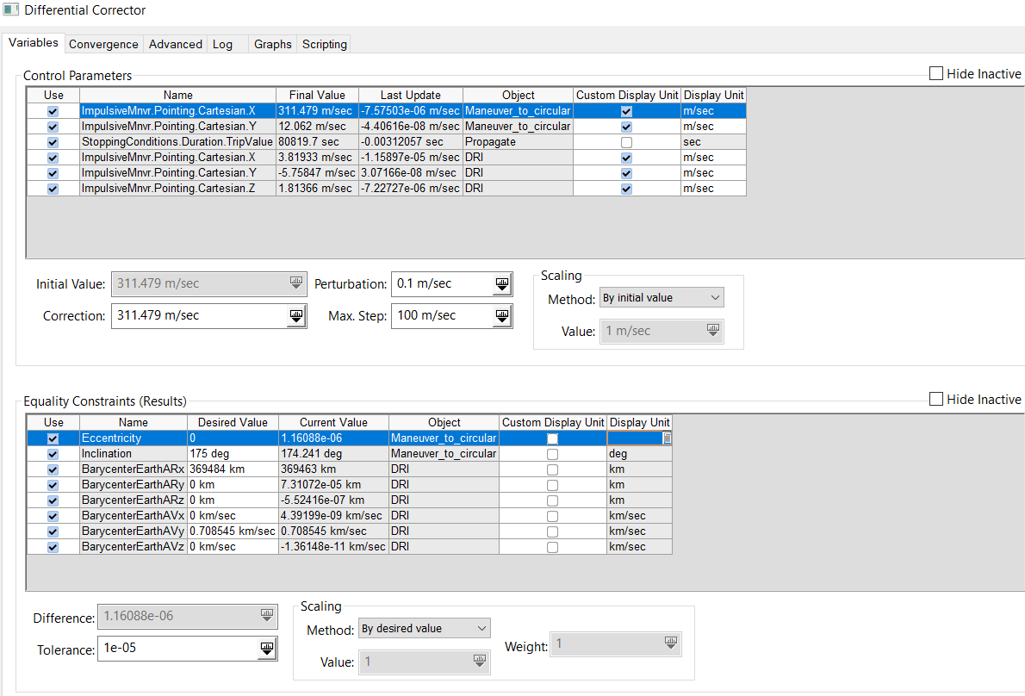
Talking Points: "In the final two phases, we performed the last maneuvers. First, in phase three, we targeted an eccentricity of zero to circularize our staging orbit, which you can see in the results panel. This cost about 311 m/s. Then, in the same targeting profile, we allowed the 'trip time' to vary, enabling the corrector to find the exact point to perform the final insertion burn. This last burn precisely matched our position and velocity to the target DRO's state vector, costing only an additional 7.14 m/s. This staged approach was key to solving the complex targeting problem."
3. Phase 3,4: Circularization, Insertion

Slide 16
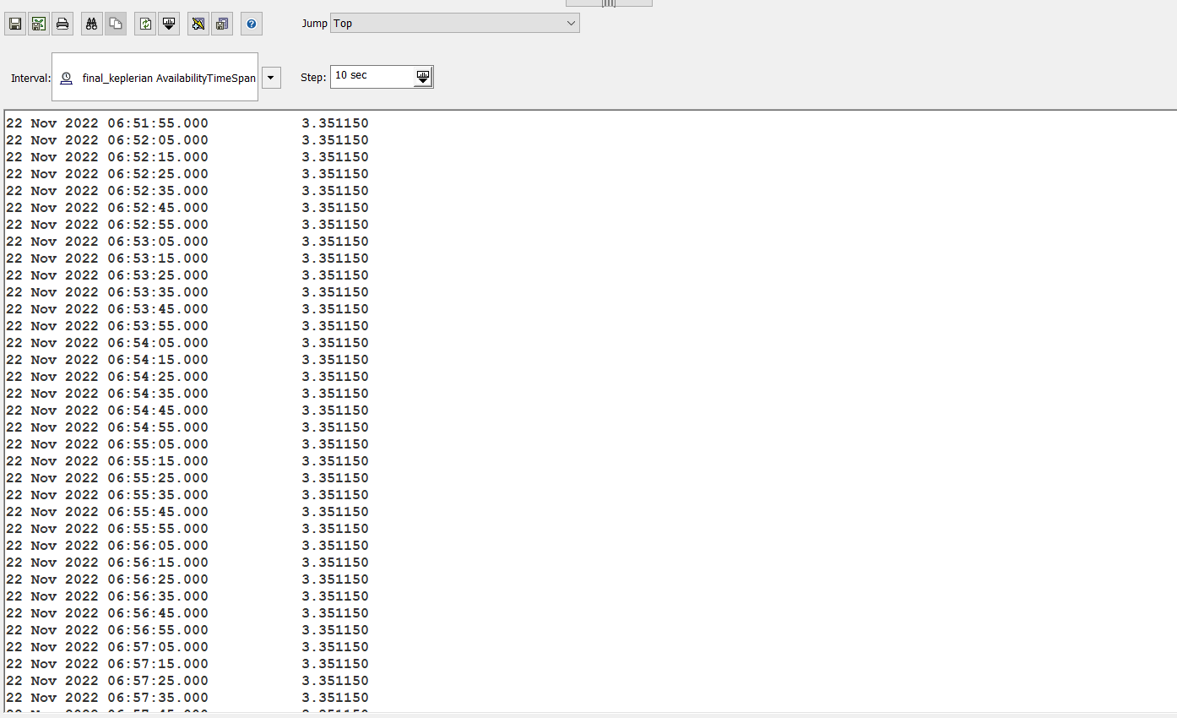
Talking Points: "To scientifically validate our simulation, we analyzed the Jacobi Constant. As you can see from this report generated by STK, after our final insertion maneuver, the value stabilizes perfectly at approximately 3.351150. This confirms that the spacecraft has settled into a stable energy state. Critically, this value matches the theoretical Jacobi Constant for the specific DRO we chose from the JPL database. This match proves that our simulation is not just visually correct, but dynamically accurate."
4. Validation: Jacobi Constant

Slide 17
On the left, we see an Earth-Centered Inertial (ECI) frame.
In this system, the Earth's body rotates on its axis, while the Moon both rotates on its own axis and revolves around the Earth.«
The view is zoomed out to capture the 'big picture', showing the moon, the earth, and the spacecraft all at once.
Right one is an Earth-Centered Inertial (ECI) frame too.
As the simulation plays, you'll notice the color of the trajectory line changes. This helps us track which phase of the mission we're in at any given moment. The colors you'll see in the simulation match the color-coded diagram on the right. For instance, we see our launch trace in green, and it's also green on the diagram.
Now lets watch this
We are launching from Florida Cape canevarel
We are coasting until our constraints met for TLI
Here we are on the way to MOON, it takes 5.2 days to reach moon. similar to Artemis1 mission
We are approaching to moon from North with an inclination of 173 degrees, it is same with our DRO orbit’s inclination.
As we know Artemis had same inclination.
At the closest point for the moon targeted 100km, so we are burning to reach DRO at apogee point of our orbit. Then we are making circulization at the apogee
When we are on circular orbit, there is intersection with our circualr orbit and DRO, so we are making a tiny manauver to reach DRO.
4. Animation I
You can watch simulation videos from media files

Slide 18
Now, let's watch the same sequence from a different perspective. This is a Moon-fixed frame, which clearly shows the trajectory relative to the Moon itself. You can see the spacecraft arriving on its hyperbolic path, performing the capture maneuver into the large elliptical orbit, then the circularization burn, and finally settling into the stable Distant Retrograde Orbit.
4. Animation II
You can watch simulation videos from media files

Slide 19
"In conclusion, this project has led to several key findings. First, the Earth Escape Barrier remains a fundamental constraint for CubeSats. Second, CubeSats are capable of significant cislunar maneuvers, but the choice of orbit is critical for the ΔV budget. Our simulation, targeting a relatively small DRO, required about 620 m/s for capture and shaping. Third, this leads to an important evaluation: targeting larger-radius DROs, as seen in the Artemis mission, could potentially lower these capture BURNS, as less braking is required. Fourth, our transfer profile, with its distinct maneuver phases, is well-suited for low-thrust electric propulsion systems. Finally, our high-fidelity simulation confirms that this complex, staged trajectory is not just theoretical but practically achievable with modern tools."
5. Conclusion & Evaluation
Finding 1: Earth escape requires a "ride" (Rideshare/OTV).
Finding 2: Cislunar maneuvering is feasible, but orbit choice is critical for ΔV budget.
Finding 3: Targeting larger-radius DROs can further reduce capture costs.
Finding 4: The transfer profile is suitable for low-thrust electric propulsion.
Validation: High-fidelity simulation confirms practical feasibility of the staged approach.

Slide 20
This concludes my presentation. Thank you very much for your time and attention. I would be happy to answer any questions you may have
Trajectory Design for Lunar CubeSat Missions
26.06.2024
Ahmet Fevzi Akargöl

